Slide 1
PROPERTY LISTING MANAGEMENT & ANALYTICS PORTAL
Team members:
P.Nithya sai – 2520030517
d.Namith rao - 2520030249

Slide 2
ABSTRACT:
The Property Listing Management & Analytics Portal is a web-based application designed to simplify real-estate property management. It provides a centralized platform for property owners and agents to add, update, delete, and manage property listings.
Users can search and filter properties based on location, price, property type, area, bedrooms, amenities, and availability.
The system also provides an analytics dashboard with charts and reports to help analyze property listings, prices, locations, types, and availability.
An admin module allows administrators to manage users, verify listings, and monitor platform activities.

Slide 3
PROBLEM STATEMENT:
Current real-estate property management can face several challenges:
Property information may be scattered across different platforms.
Managing property listings manually is time-consuming.
Users may find it difficult to search for suitable properties quickly.
Comparing properties based on price, location, type, and amenities can be difficult.
Lack of centralized analytics makes it difficult to understand property trends.
Administrators need an efficient way to manage users and verify listings.

Slide 4
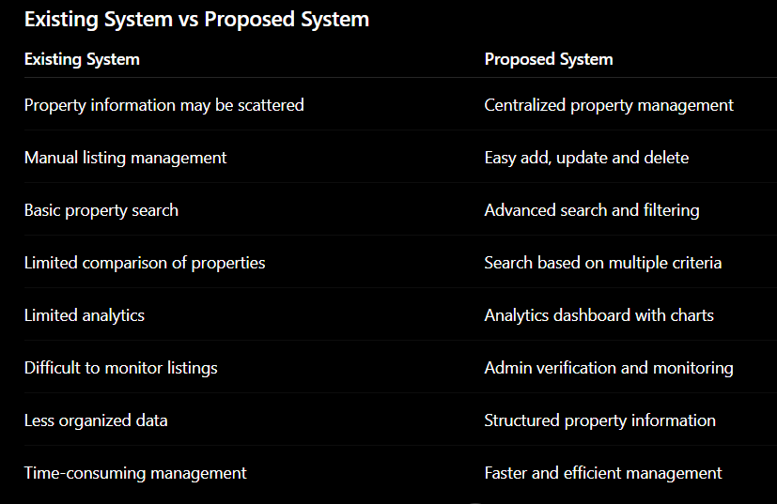
EXISTING VS PROPOSED SYSTEM:

Slide 5
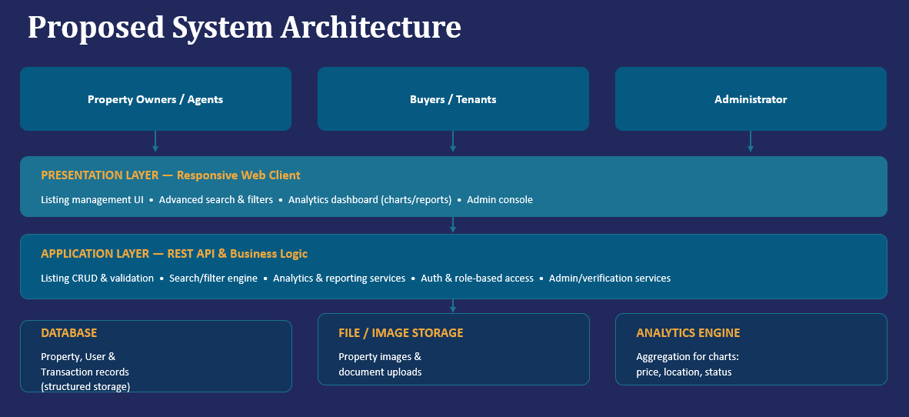

Slide 6
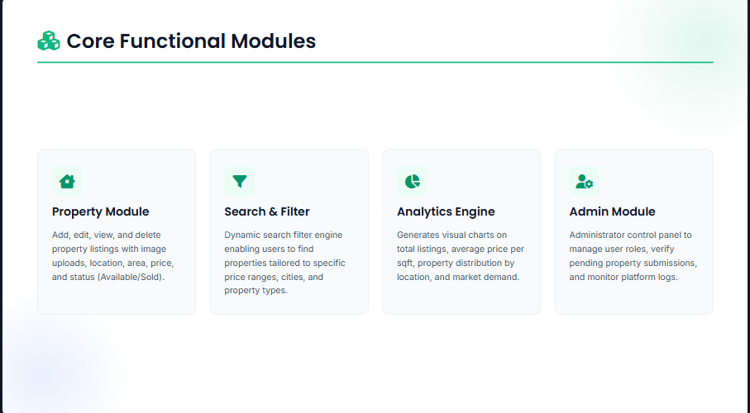
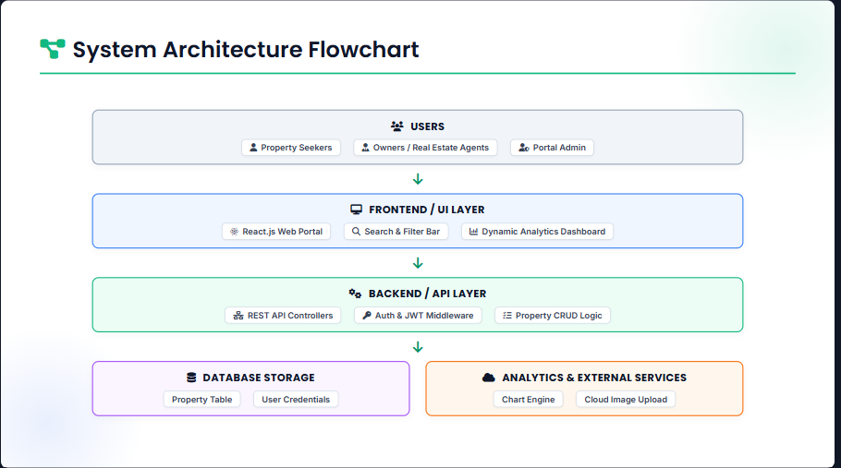
PROPOSED SYSTEM ARCHITECTURE:

Slide 7
TOOLS & TECHNOLOGIES:
Frontend
HTML5
CSS3
JavaScript
React.js
Backend
Node.js
Express.js
Database
MySQL
Development Tools
Visual Studio Code
Git / GitHub

Slide 8
CONCLUSION:
Provides a centralized platform for property management.
Makes property searching faster and easier.
Helps owners and agents efficiently manage listings.
Provides analytics and visual reports for better decision-making.
Admin module improves listing verification and platform management.

Slide 9
Thank you

